Slide 1
Address Calculation in Array & Sparse Matrices

Slide 2
STORAGE OF ARRAYS
^{𝗈} Row Major
^{𝗈} Column Major

Slide 3
ADDRESS CALCULATION FOR ARRAYS
^{𝗈} In computing, row-major order and column- major order describe methods for arranging multidimensional arrays in linear storage such as memory.
𝗈
In row-major order, consecutive elements of the rows of the array are in contiguous memory; in column-major order, consecutive elements of the columns are contiguous.

Slide 4
a11 | a12 | a13
a21 | a22 | a23
^{𝗈} A =
^{𝗈} Column Major
Row Major
Address | Value
0 | a11
1 | a21
2 | a12
3 | a22
4 | a13
5 | a23
Address | Value
0 | a11
1 | a12
2 | a13
3 | a21
4 | a22
5 | a23

Slide 5
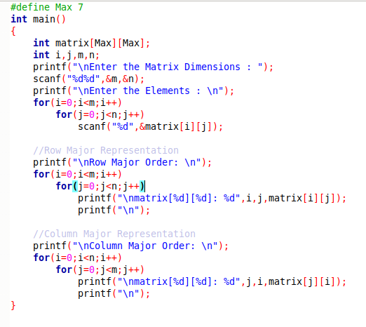

Slide 6

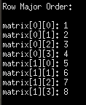
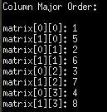

Slide 7
ROW MAJOR ORDER
The Location of element A[i, j] can be obtained by evaluating expression:
LOC (A [i, j]) = Base_Address + W [M (i) + (j)]
Base_Address is the address of first element in the array.
W is the word size. bytes occupied by each element.
N is number of rows in array.
M is number of columns in array.
^{𝗈} Base_Address = 2000, W= 2, M=4, N=2, i=1, j=2
^{𝗈} LOC (A [i, j])=Base_Address + W [M (i) + (j)]
LOC (A[1, 2])=2000 + 2 *[4*(1) + 2]
=2000 + 2 * [4 + 2]
=2000 + 2 * 6
=2000 + 12
=2012

Slide 8
COLUMN MAJOR
^{𝗈} The Location of element A[i, j] can be obtained by evaluating expression:
LOC (A [i, j]) = Base_Address + W [N (j) + (i)]
𝗈
Base_Address is the address of first element in the array.
W is the word size. bytes occupied by each element.
N is number of rows in array.
M is number of columns in array.
Suppose we want to calculate the address of element A [1, 2].
Base_Address = 2000, W= 2, M=4, N=2, i=1, j=2
^{𝗈} LOC (A [i, j])=Base_Address + W [N (j) + (i)]
^{𝗈} LOC (A[1, 2])=2000 + 2 *[2*(2) + 1]
=2000 + 2 * [4 + 1]
=2000 + 2 * 5
=2000 + 10
=2010

Slide 9
SPARSE MATRIX
sparse … many elements are zero dense … few elements are zero

Slide 10
a sparse matrix is a matrix in which most of the elements are zero.
𝗈
𝗈
^{𝗈} Application areas
Network theory, which have a low density of significant data or connections.
scientific or engineering applications.
Computer Graphics Recommendor System Machine Learning Information Retrieval
●
●
●

Slide 11
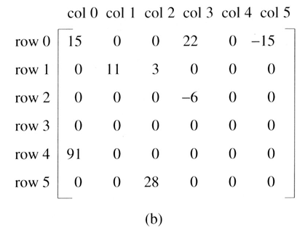
EXAMPLE

Slide 12
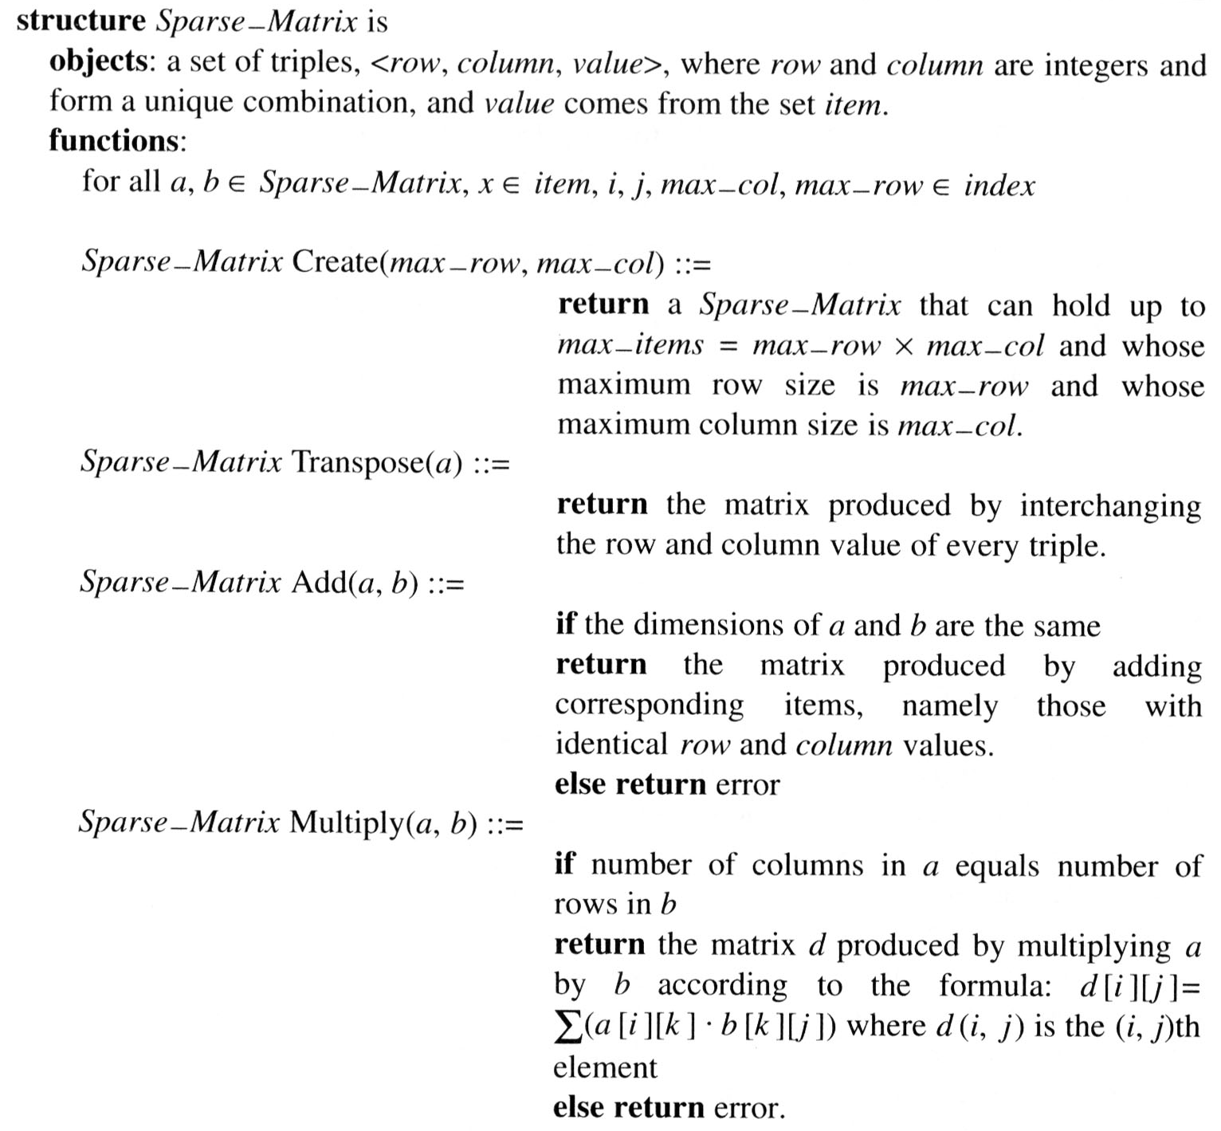
A minimal set of operations includes matrix creation, addition, multiplication, and transpose.

Slide 13
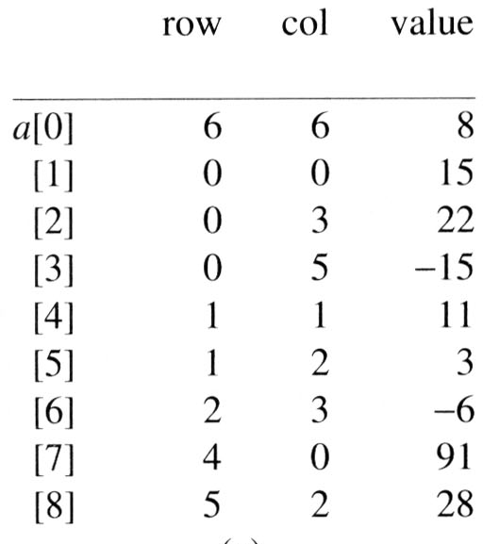
REPRESENTATION OF CONVENTIONAL INTO SPARSE MATRIX
^{𝗈} 2D array
Declaration Sparse_arr[Max][3]
^{𝗈} Array of Structure

Slide 14
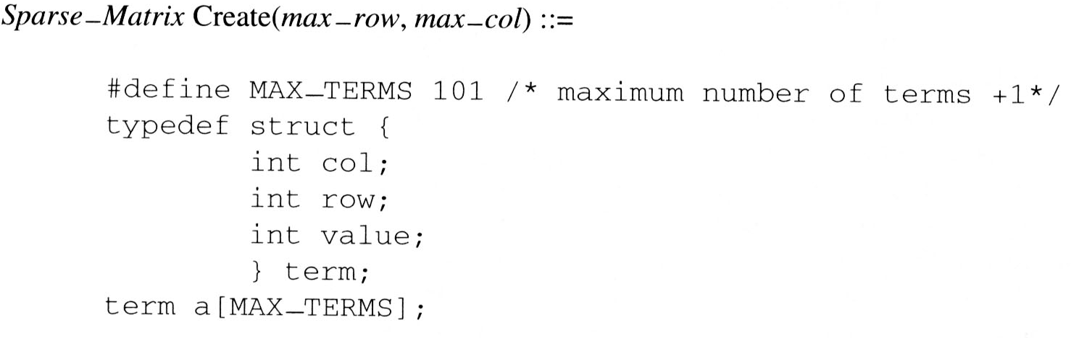
DECLARATION OF SPARSE MATRIX

Slide 15
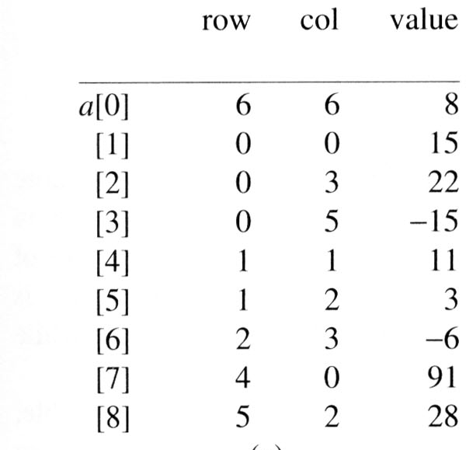
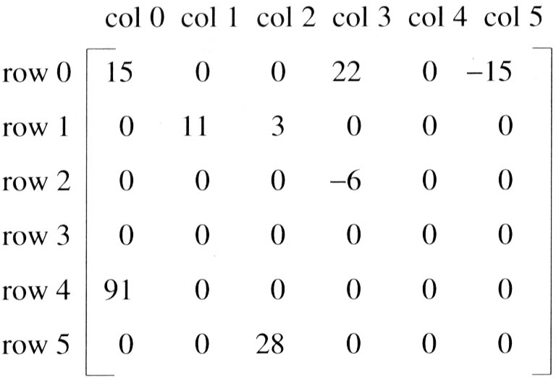

Slide 16
ADDITION OF TWO SPARSE MATRICES

Slide 17
Algorithm
Obtain the triplet form of both(A and B) sparse matrix.
Create new triplet to store result as result matrix( C).
Copy number of rows and column from any sparse matrix to result matrix.
Let i, j, k be indices of A,B,C respectively.
Initialize i, j, k to 1.
Traverse A and B from second row.
If (row number of A== row number of B)
{
if(column number of A== column number of B)
add non zero values and store the result in C by incrementing the indices.
else
whichever has less column value copy that to C by incrementing respective indices
}
Else
Compare rows of both A and B and whichever has less row value copy that to C by incrementing respective indices
Repeat step 6 till the end of any matrix triplet
Copy the remaining terms of sparse matrix(if any) to C

Slide 18
Sparse A
Sparse B
Resultant Sparse C
 | row | col | val
0 | 10 | 10 | 9
1 | 1 | 2 | 5
2 | 2 | 5 | 8
3 | 2 | 9 | -9
4 | 4 | 7 | -15
5 | 5 | 4 | 10
6 | 6 | 1 | 80
7 | 8 | 4 | 19
8 | 8 | 7 | 21
9 | 9 | 8 | 5
 | row | col | val
0 | 10 | 10 | 8
1 | 1 | 2 | 10
2 | 2 | 5 | 10
3 | 2 | 8 | 2
4 | 3 | 6 | -5
5 | 4 | 2 | 11
6 | 5 | 4 | 44
7 | 8 | 3 | 5
8 | 9 | 1 | 10
 | row | col | Val
0 | 10 | 10 | 13
1 | 1 | 2 | 15
2 | 2 | 5 | 18
3 | 2 | 8 | 2
4 | 2 | 9 | -9
5 | 3 | 6 | -5
6 | 4 | 2 | 11
7 | 4 | 7 | -15
8 | 5 | 4 | 54
9 | 6 | 1 | 80
10 | 8 | 3 | 5
11 | 8 | 4 | 19
12 | 8 | 7 | 21
13 | 9 | 1 | 10
14 | 9 | 8 | 5
+
=

Slide 19
TRANSPOSE OF SPARSE MATRIX

Slide 20
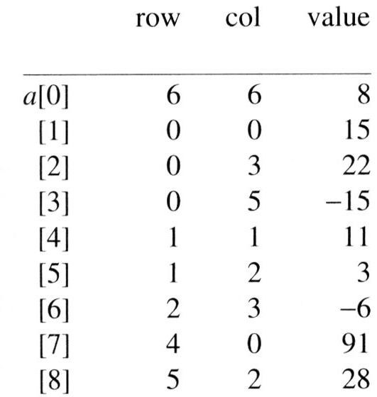

Slide 21
(1) for each row i
take element <i, j, value> and store it
in element <j, i, value> of the transpose.
difficulty: where to put <j, i, value>
(0, 0, 15) | ====> | (0, 0, 15)
(0, 3, 22) | ====> | (3, 0, 22)
(0, 5, -15) | ====> | (5, 0, -15)
(1, 1, 11) | ====> | (1, 1, 11)
Move elements down very often.
(2) For all elements in column j,
place element <i, j, value> in element <j, i, value>

Slide 22
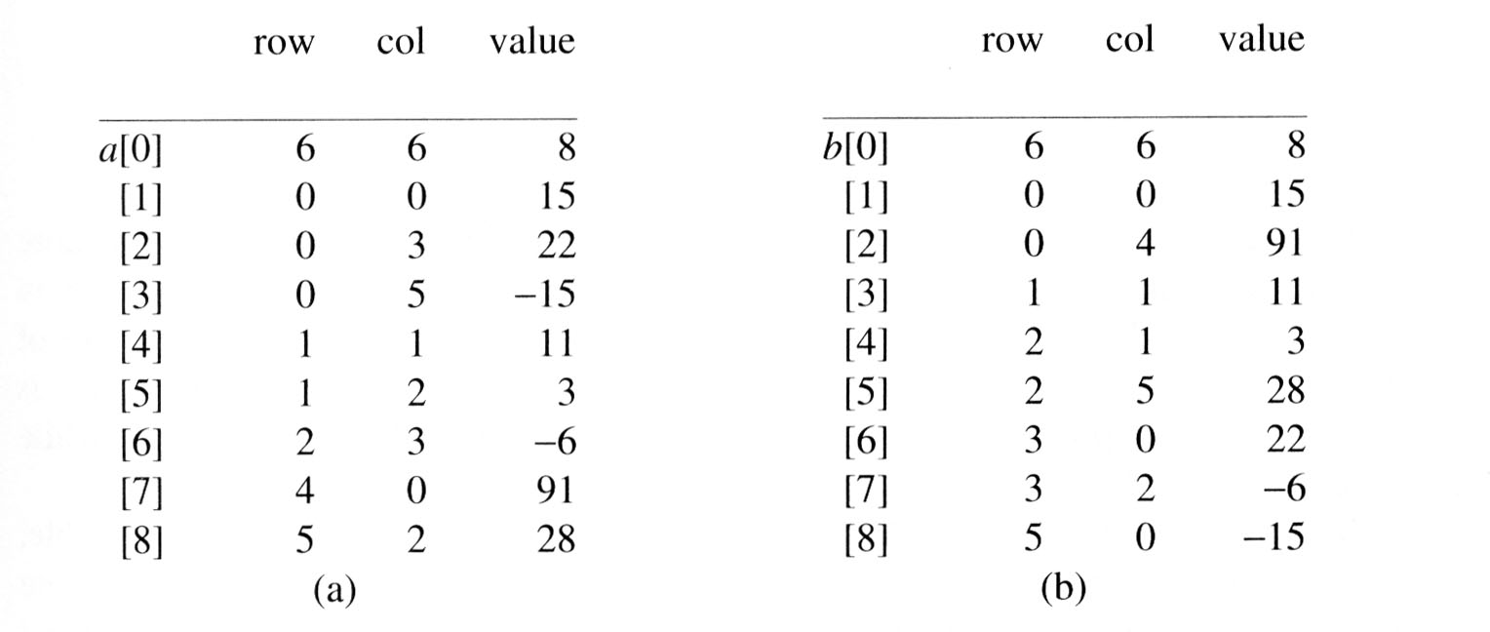

Slide 23
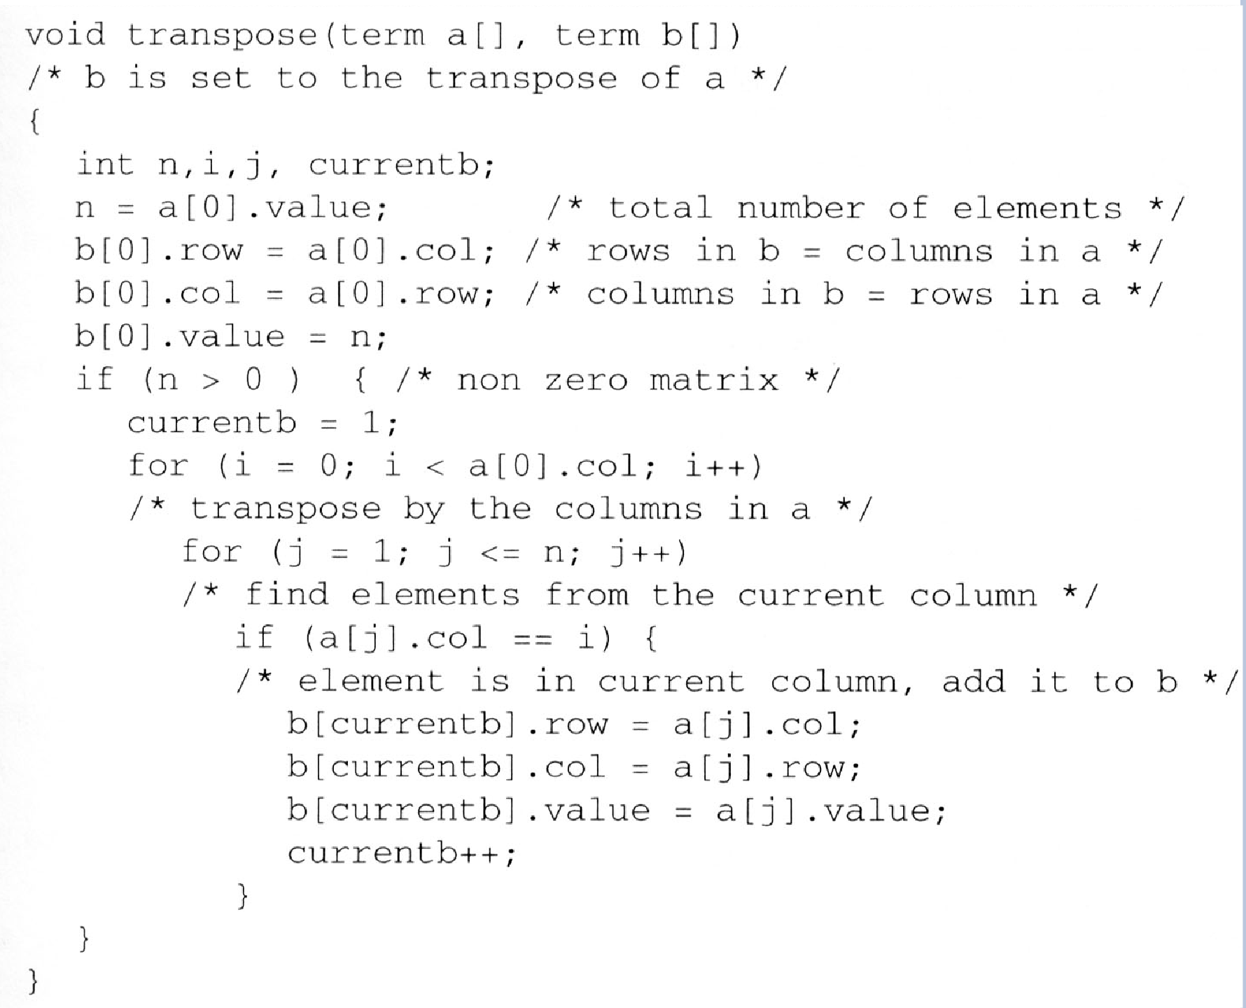
SIMPLE TRANSPOSE

Slide 24
Multiplication
To Multiply the matrices, we first calculate transpose of the second matrix to simplify our comparisons and maintain the sorted order. So, the resultant matrix is obtained by traversing through the entire length of both matrices and summing the appropriate multiplied values.
Any row value equal to x in the first matrix and row value equal to y in the second matrix (transposed one) will contribute towards result[x][y]. This is obtained by multiplying all such elements having col value in both matrices and adding only those with the row as x in first matrix and row as y in the second transposed matrix to get the result[x][y].

Slide 25
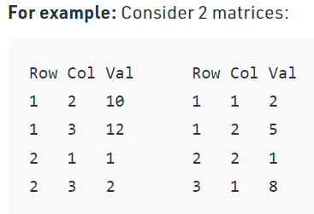
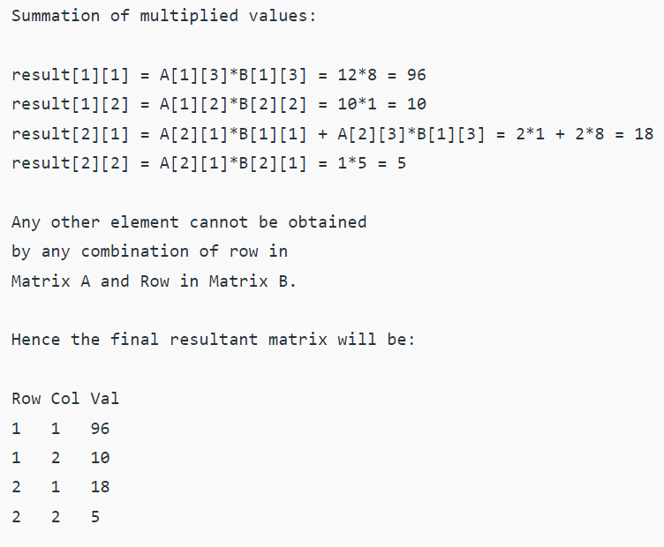
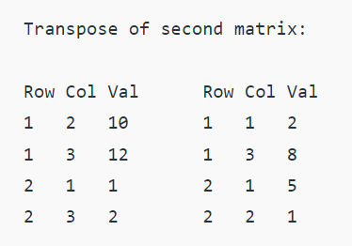
Example

